Slide 1
Data Visualization in R
Jenn Schilling
April 12, 2021

Slide 2

Hello!
Jenn Schilling
Senior Data Analyst, University Analytics & Institutional Research, University of Arizona
Adjunct Faculty, System Design Thinking, College for Creative Studies

Slide 3
Day 1 Agenda
Why is data visualization important?
Best practices in data visualization
Data visualization in R
R setup
How to make a scatterplot in R
How to make a line graph in R
Questions

Slide 4
Learning Outcomes
Explain how the grammar of graphics works in R
Create three different plots in R
Add titles and labels to a plot in R
Change the formatting of a plot in R

Slide 5
Why visualize data?
Gain understanding
Show patterns
Engage viewer
Convince viewer
Tell a story
Notes:
But need to be careful with patterns because we can easily jump to conclusions and see causality when it is not there. Need to be careful with storytelling too because we must ensure that we are accurately and truthfully representing the data. Explore the data first and then craft the message rather than the other way around.

Slide 6
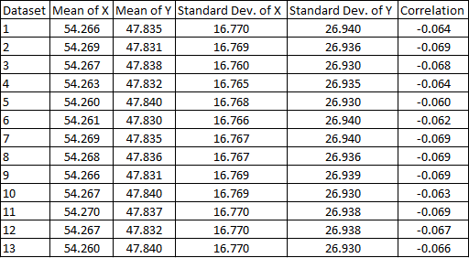
Datasets of (x, y) coordinate pairs

Slide 7
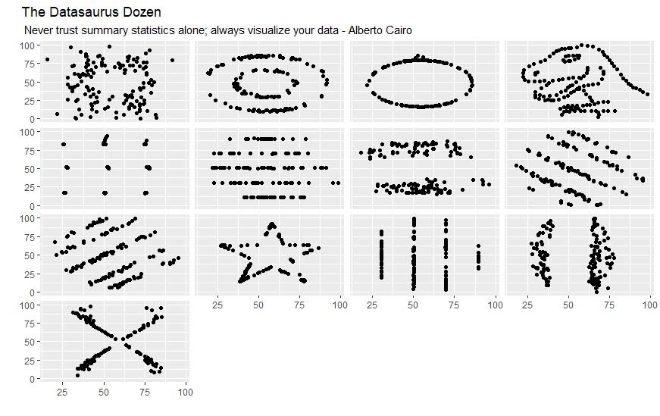
Datasets Visualized

Slide 8
Best Practices in Data Visualization
“A good visualization is:
reliable information,
visually encoded so relevant patterns become noticeable,
organized in a way that enables at least some exploration, when it’s appropriate,
and presented in an attractive manner, but always remembering that honesty, clarity, and depth come first.”
(Cairo, 2016, p. 12)
Notes:
What makes an effective data visualization?
This is not a simple question with a straightforward answer, but broadly speaking, it is important to be honest and truthful and accurately represent the data while keeping in mind the audience, the goal to inform the audience, and the principles around how humans perceive visual elements.
Cairo, A. (2016). The truthful art: Data, charts, and maps for communication. New Riders

Slide 9
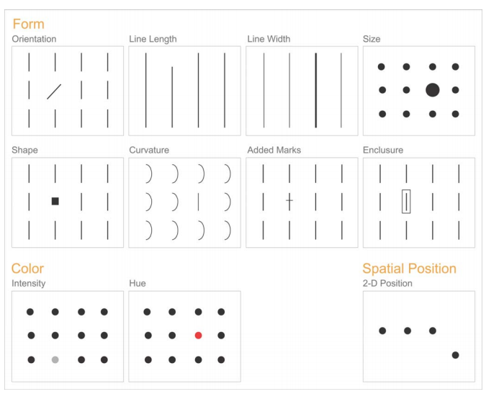
Best Practices in Data Visualization
(Few, 2004, p. 5)
Notes:
Preattentive attributes
Source: https://www.perceptualedge.com/articles/ie/visual_perception.pdf

Slide 10
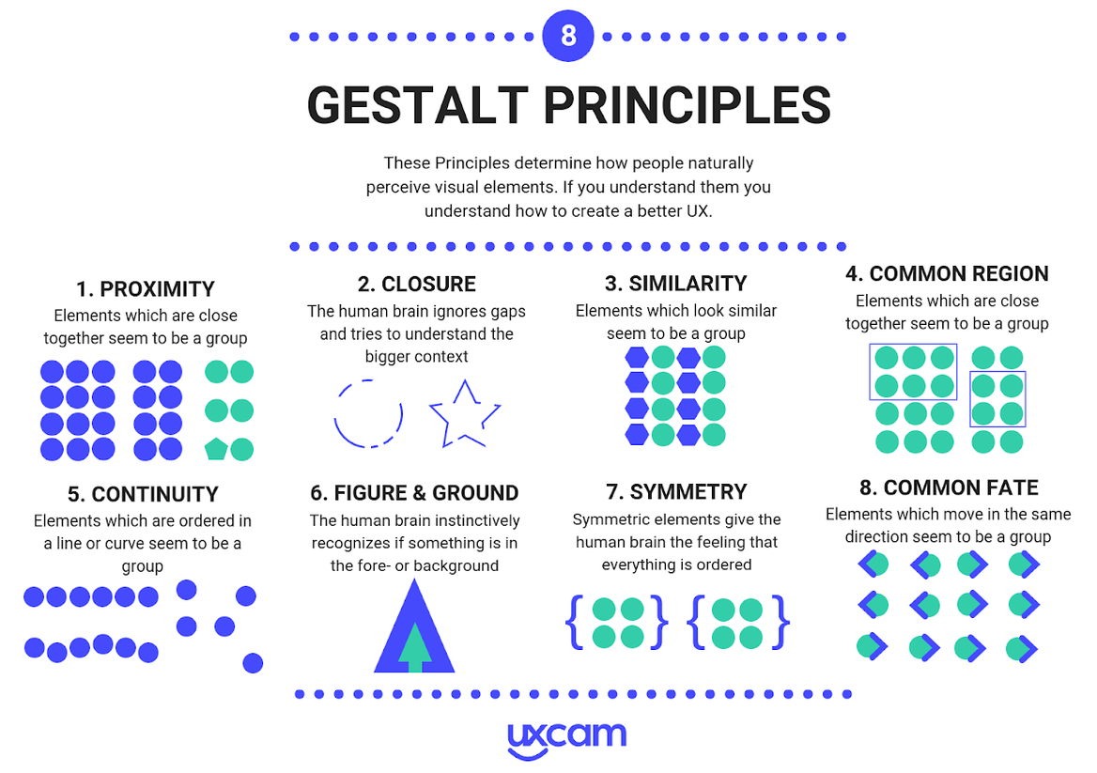
Best Practices in Data Visualization
(Bufe, 2019)
Notes:
Gestalt Principles
Source: https://uxcam.com/blog/gestalt-principles/

Slide 11
Best Practices of Data Visualization
The Five Qualities of Great Visualizations:
Truthful
Functional
Beautiful
Insightful
Enlightening
(Cairo, 2016, p. 45)
Notes:
Cairo, A. (2016). The truthful art: Data, charts, and maps for communication. New Riders

Slide 12

Data Visualization in R
Library: ggplot2
Robust
Iterative
Flexible
Functional

Slide 13
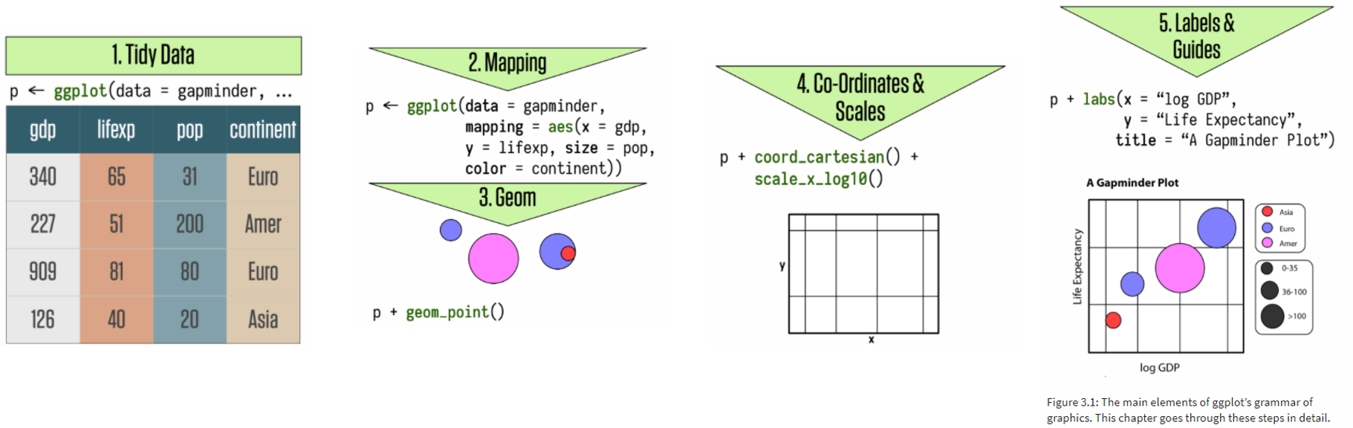
The Grammar of Graphics
The basis of ggplot2
Build plots in layers:
Data to be visualized
Aesthetic mappings
Geometric objects
Statistical transformations
Coordinates
Scales
Facets
(Wickham, 2010, p. 8; Healy, 2019, p. 56)
Notes:
gg = grammar of graphics
Source: http://vita.had.co.nz/papers/layered-grammar.pdf
Source: Healy, K. (2019). Data visualization: A practical introduction. Princeton ; Oxford: Princeton University Press

Slide 14
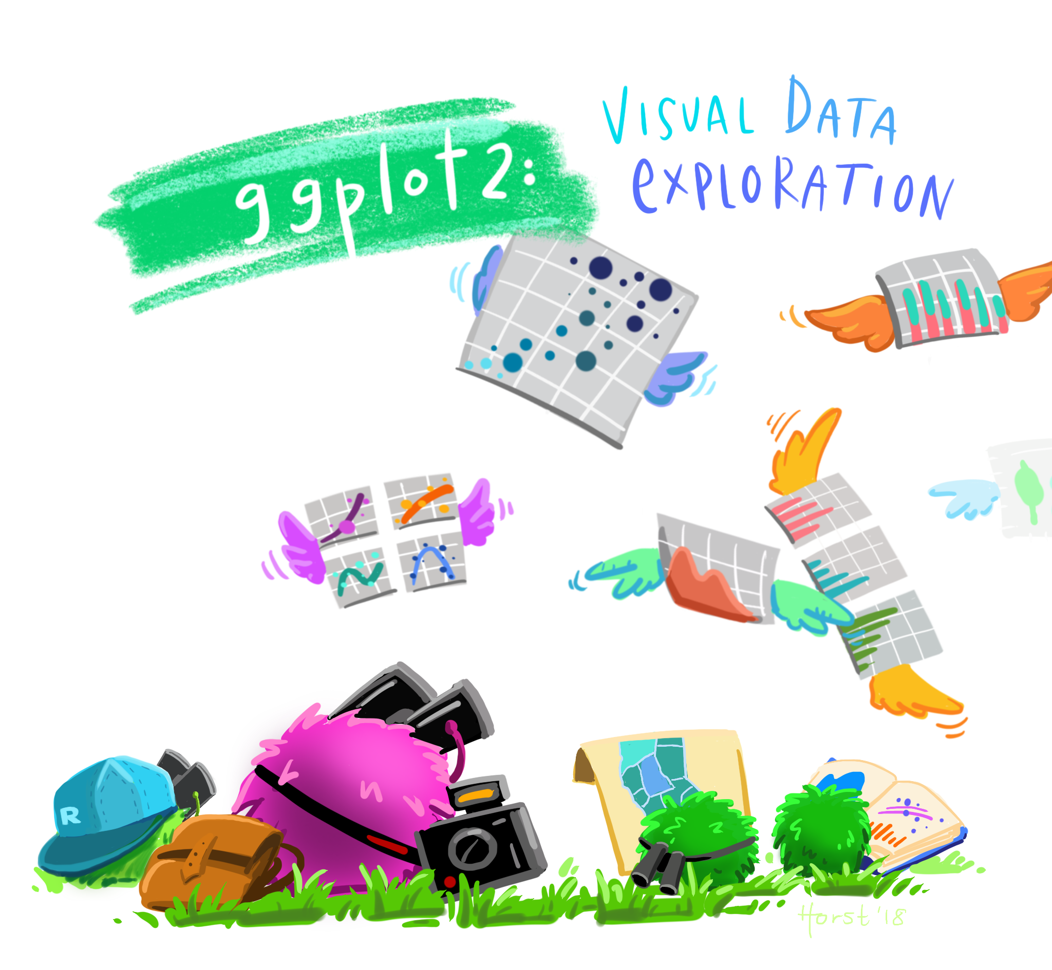
Artwork by @allison_horst

Slide 15
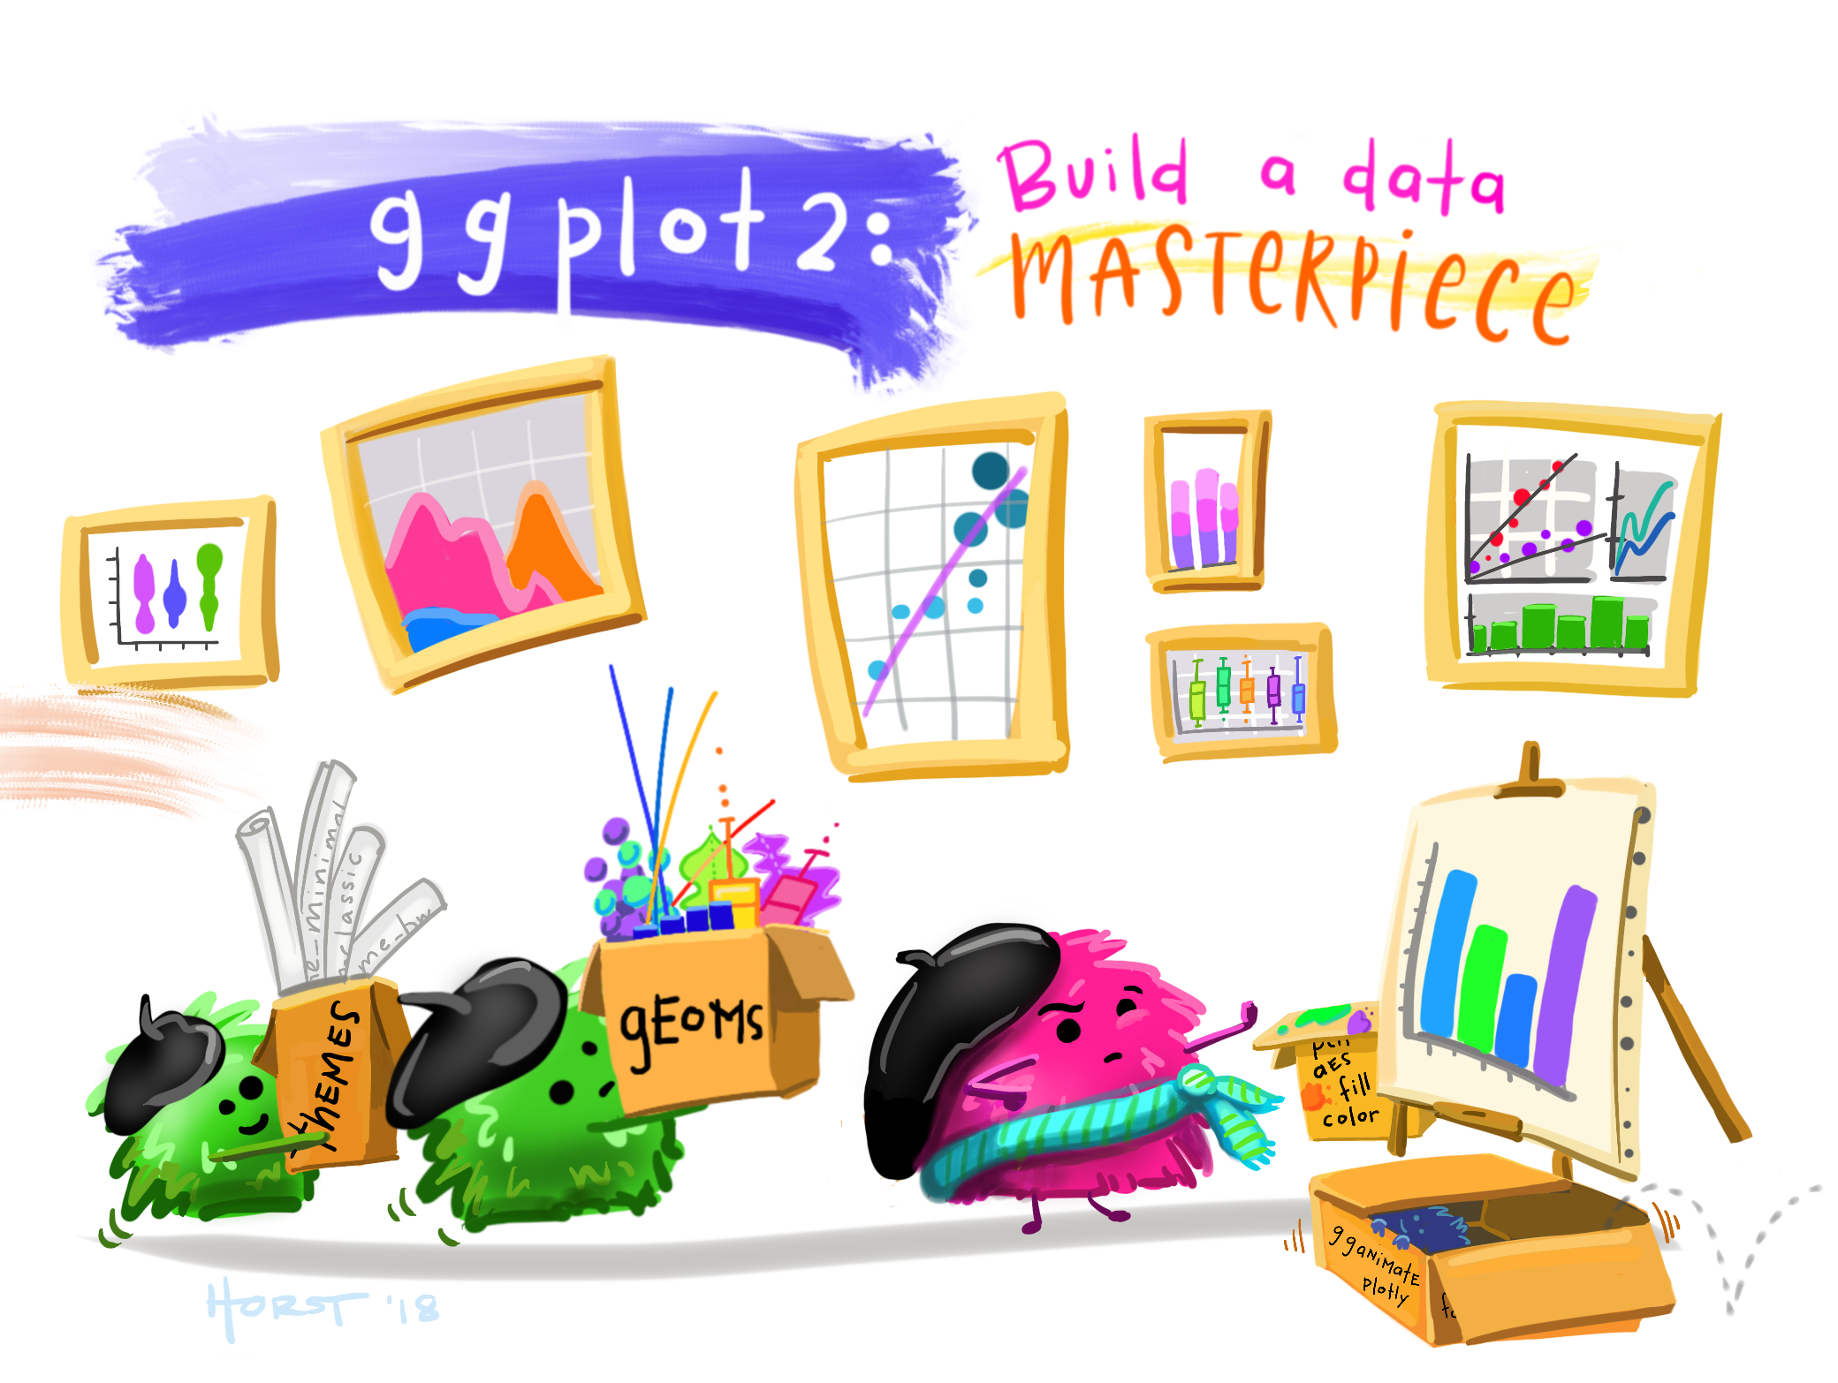
Artwork by @allison_horst

Slide 16
R Setup
R Markdown
tidyverse package
Tidy data

Slide 17
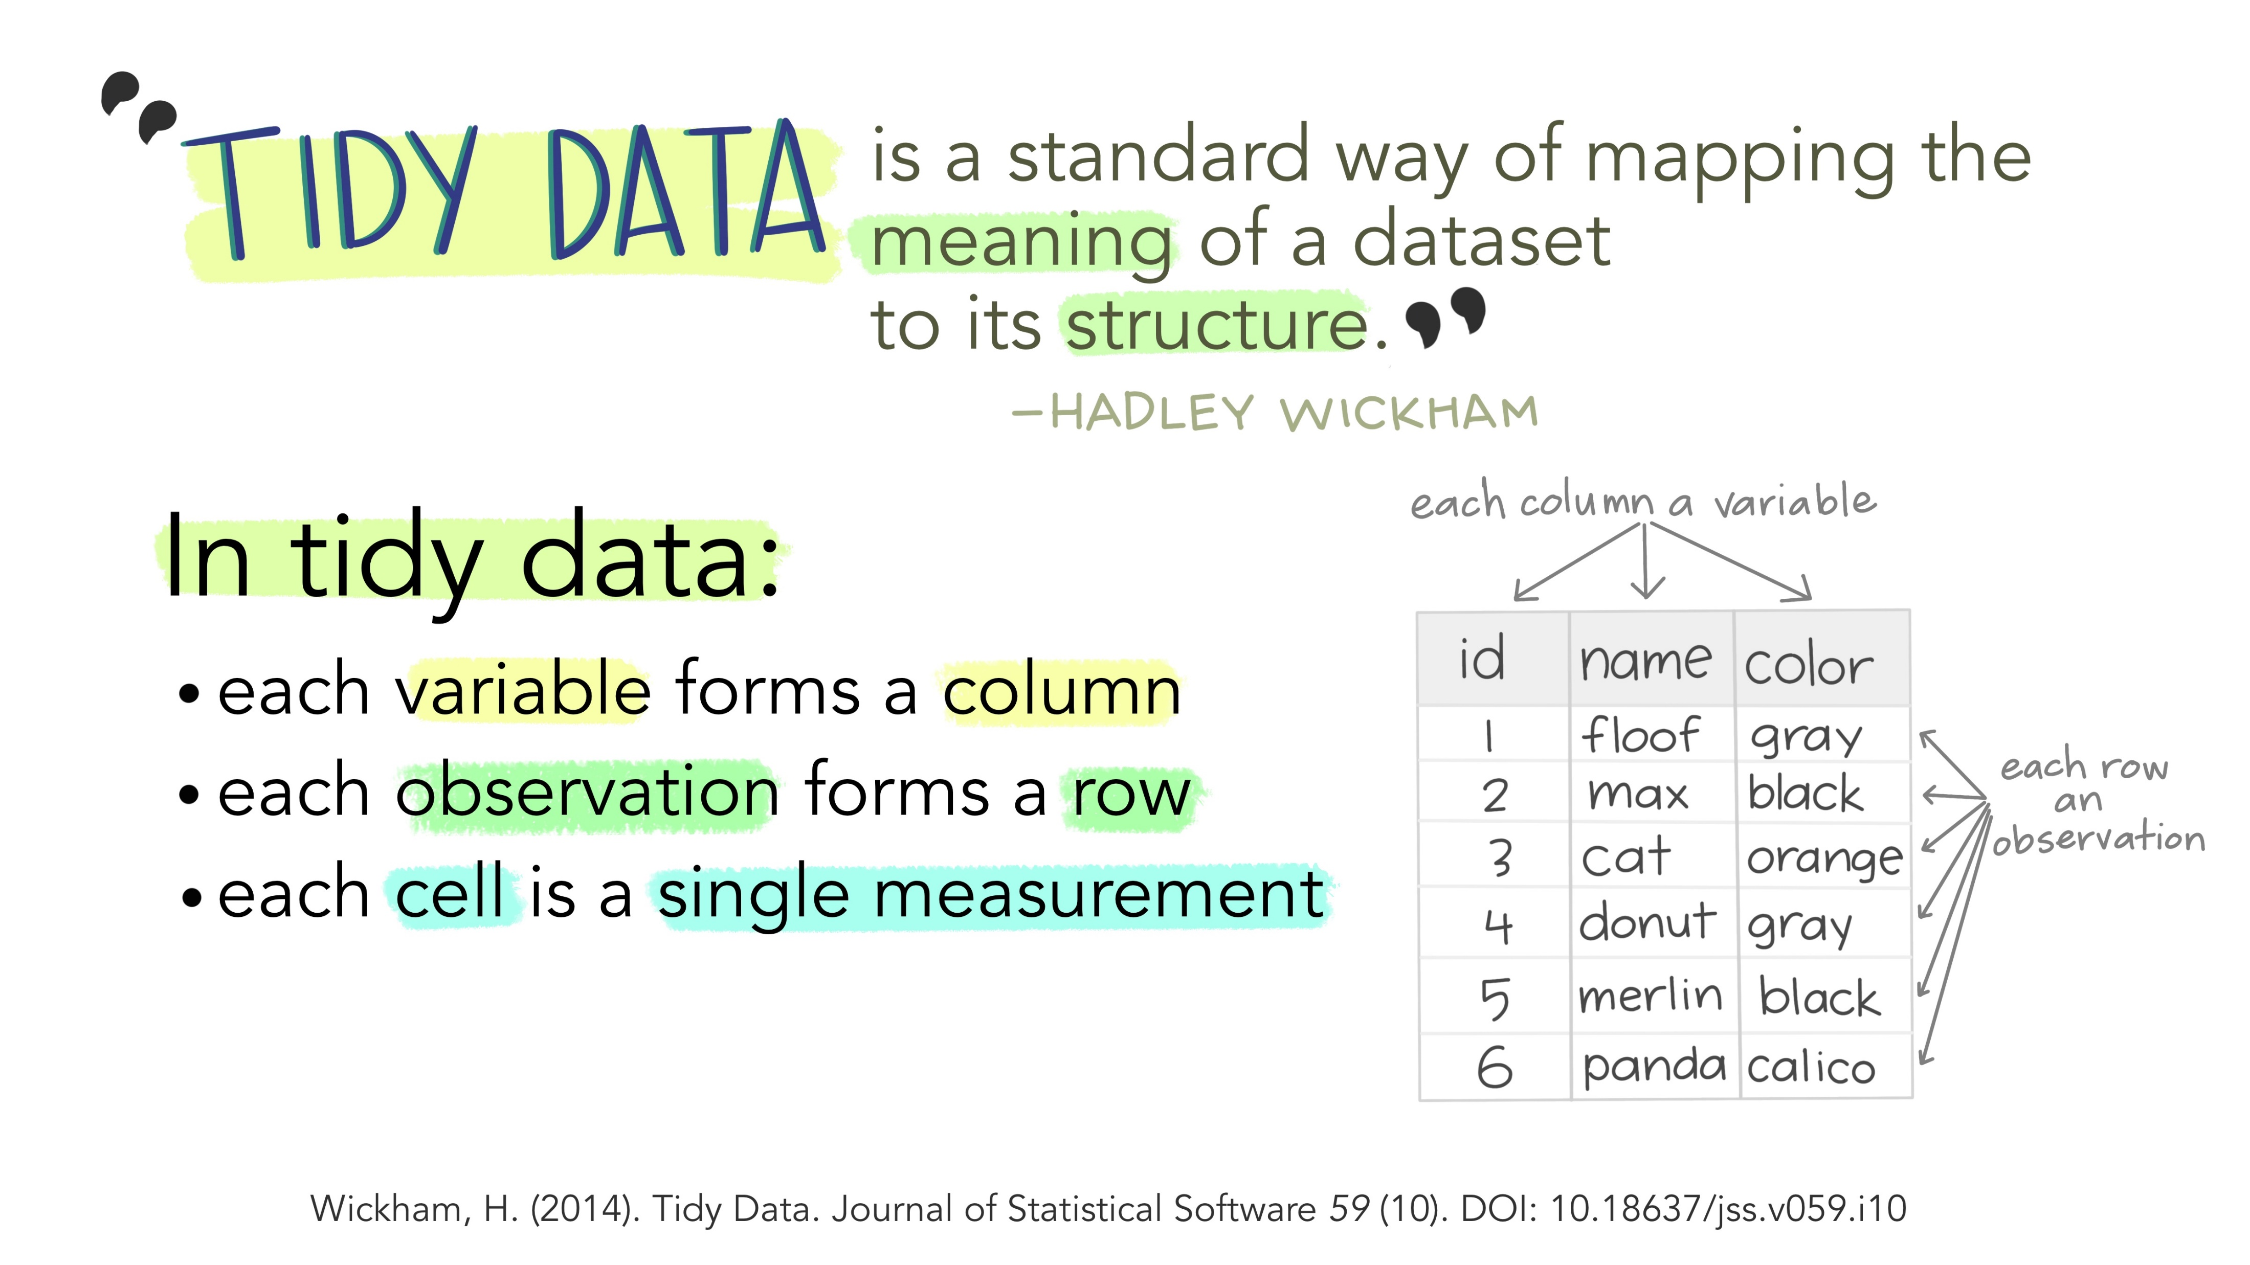
Illustrations from the Openscapes blog Tidy Data for reproducibility, efficiency, and collaboration by Julia Lowndes and Allison Horst

Slide 18
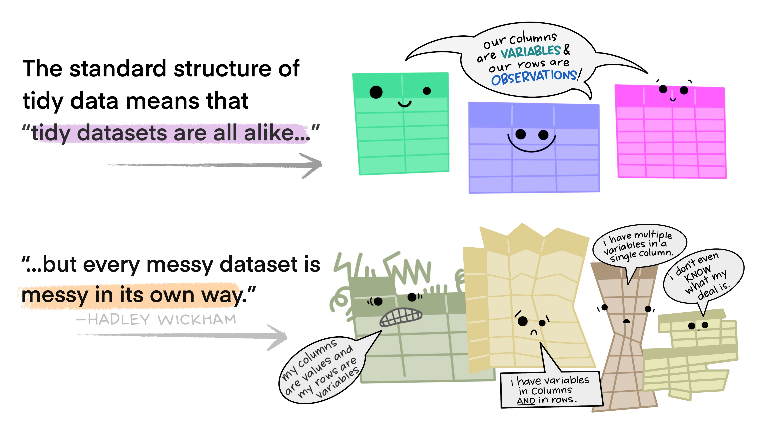
Illustrations from the Openscapes blog Tidy Data for reproducibility, efficiency, and collaboration by Julia Lowndes and Allison Horst

Slide 19
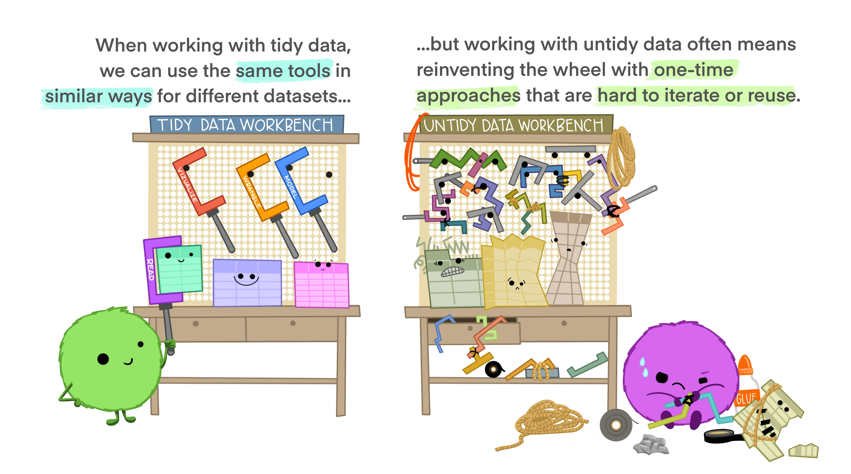
Illustrations from the Openscapes blog Tidy Data for reproducibility, efficiency, and collaboration by Julia Lowndes and Allison Horst

Slide 20
Scatterplots

Slide 21
Line Graph

Slide 22
What did we learn today?
Basic principles of data visualization
Motivation for using ggplot2
How to get started with ggplot2
How to make a scatterplot in R
How to make a line graph in R

Slide 23
Questions

Slide 24
Data Visualization in R
Jenn Schilling
April 13, 2021

Slide 25
Day 2 Agenda
Recap of previous session
How to make a bar graph in R
Adding and changing titles and labels in R
Formatting options for plots in R
How to save a plot in R
Where to go from here
Questions

Slide 26
Learning Outcomes
Explain how the grammar of graphics works in R
Create three different plots in R
Add titles and labels to a plot in R
Change the formatting of a plot in R

Slide 27
Quick Recap
Grammar of graphics
R setup
Making a plot

Slide 28
Bar Graphs

Slide 29
Titles and Labels

Slide 30
Formatting

Slide 31
Saving

Slide 32
Where to go next
ggplot2: Elegant Graphics for Data Analysis by Hadley Wickham
Data Visualization Chapter in R for Data Science by Hadley Wickham & Garrett Grolemund
ggplot2 Reference Guide

Slide 33
What did we learn today?
How to make a bar graph in R
How to make add titles and labels to a graph in R
How to change the formatting of a graph in R
How to save a graph in R
Where to find more information on ggplot2

Slide 34
Questions

